Slide 1


Slide 2

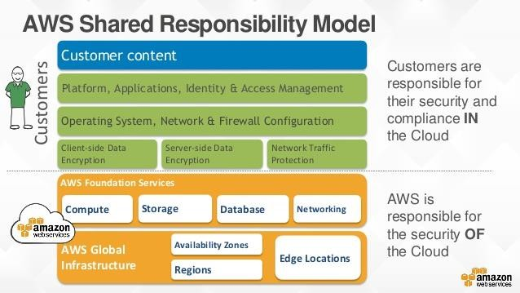

Slide 3
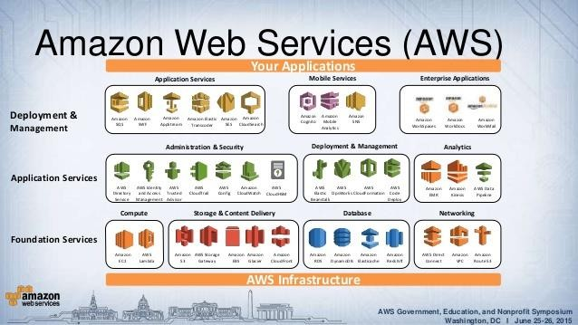

Slide 4

Anything with AWS access should have the minimal rights it needs to accomplish its specific actions
Ex: If an application only needs read access to files in S3, then create an IAM role with only “GetObject” rights on S3
A user should only have access to the data, hardware that they need, to be able to perform their assigned duties.

Slide 5

Centralized mechanism for creating and managing users
A user is an identity with unique security credentials
No need to share passwords or keys
Easy to enable / disable user’s access
Create user accounts and roles, and configure permissions for them
Implement security best practices such as least privilege

Slide 6
Root account created upon first sign-in
Provides complete, unrestricted access
Best practice is to NOT use your root account for everyday access
Administrator group should be created to grant access to AWS account resources
Should not share your root account
https://docs.aws.amazon.com/IAM/latest/UserGuide/getting- started.html

Slide 7
Policies
Lists one or more permissions
Used to assign permissions to a user/group/role/resource
Customer-managed Policies
Provides more precise control over permissions in policies
AWS-managed policies
Provide permissions for many common use cases
Easier to assign to users, groups and roles
Apply only to identities not resources
https://docs.aws.amazon.com/IAM/latest/UserGuide/access_policies.html

Slide 8
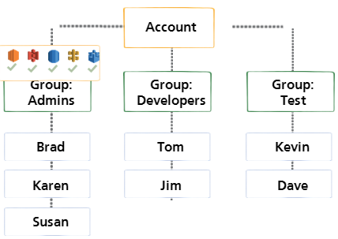
AWS Users
Individual
System
Application
Unique name / credentials
No sharing of passwords or keys
Minimize use of root credentials
Groups
Specify permissions for similar users
Users in group are entitled to the permissions of the group
Add/remove users to alter their privileges

Slide 9
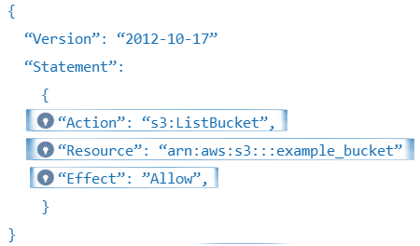
Action
Actions allowed by policy statement
Each AWS service has its own set of actions
Actions not explicitly allowed are denied by default
Resources
AWS resources affected by policy statement
Access denied by default
Effect
The effect is either allow or deny
Resources that are not explicitly allowed are denied by default

Slide 10
You can create an IAM policy by:
Copying an AWS-managed policy
Customizing a policy with AWS Policy Generator tool
Manually create in JSON format
AWS Policy Generator:
Choose products and actions from a list
Select Effect, AWS service, and Actions
Specify the ARN
Optionally add conditions
Add additional statements
https://docs.aws.amazon.com/IAM/latest/UserGuide/access_policies.html

Slide 11

IAM identity which you can associate a policy with
Can be used to delegate access to users, groups, applications and services
IAM Role use cases:
Grant access to resources in another AWS account
Sync with corporate Active Directory
Grant third party access to perform audits https://docs.aws.amazon.com/IAM/latest/UserGuide/id_roles_common- scenarios_services.html

Slide 12

Securing Access : Password Policies
Enforce strong passwords and regular changing of passwords
Allow all users to use the IAM console to change their passwords
Allow some users manage passwords, for themselves and for others
Password expiration period between 1 and 1095 days
Prevent users from reusing previous passwords
Prevent IAM users from choosing a new password after expiration

Slide 13
Provides additional layer of security
Supports hardware and virtual MFA devices
Devices linked to AWS account, generate the individual-use keys regularly
Enable AWS MFA on your AWS account and for the root user
Use MFA for privileged IAM users
Enforce MFA on specific API calls
MFA device must be unique for each user
Supports Gemalto hardware MFA device and several software MFA devices
https://aws.amazon.com/iam/details/mfa/

Slide 14
Key pairs consists of:
Private key is used to sign in securely to instance
Key pair can be generated automatically or you can upload your own during launch
Very important to:
Public Key (AWS)
Private Key (User)
Secures public-key using public-key
cryptography
When launching instances, customers can:
Use existing key pairs
Create new key pairs
Save the private key in a safe place on your system
Record the location
Key Pairs are
Region specific
Used with Linux to authenticate over SSH
Used with Windows to decrypt local administrator password for RDP connections
Public key is embedded in instance

Slide 15
Sign programmatic requests
All API requests require a digital signature
Signing protects message integrity by preventing
Man-in-the-Middle attacks
Replay attacks
Most recent is Signature Version 4, which uses the HMAC-SHA256 protocol
Save access keys in a safe place, not embedded in code
Can have two sets of active access keys at a time
Users should rotate access keys

Slide 16
AWS API Calls
Methods by which AWS services and applications communicate
Made by an authenticated IAM user, role or root account to an AWS service
Used for all interaction with AWS services
Manage AWS services from:
Applications
Third-Party tools
SDKs
AWS command line tools
AWS APIs are web services over HTTPS
TLS sessions between the client and AWS service endpoint

Slide 17

CloudTrial
Captures information about every API call
Provides description of API request errors, including authorization failures
Logs AWS Management Console sign-in events from all users
Aggregates log files from multiple regions or accounts into a single S3 bucket
Why AWS CloudTrial?
Track changes to resources
Monitor and report on user activity
Demonstrate compliance with internal policies and regulatory standards
Troubleshoot issues

Slide 18

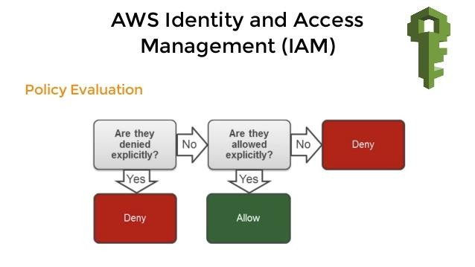
Presumed Deny

Slide 19














Slide 20




Slide 21


STS allows you to create temporary security credentials that grant trusted users access to your AWS resources
These temporary credentials are for short term use and can be active for few minutes to several hours
Once expired, they can no longer be used to access your AWS resources
When requested through an STS API call, credentials are returned with three components
Security Token
Access Key ID
Secret Access Key

Slide 22

No distribution or embedding long-term AWS security credentials in an application
Grant Access to AWS resources without having to create an IAM identity for them
The basis for IAM roles and identity federation
Since the credentials are temporary, you don’t have to rotate or revoke them
You decide how long they are active for
When to use STS
Identity Federation through Enterprise Active Directory (SAML) and Web Identity Federation
Roles for Cross Account Access
Roles for EC2 and other AWS resources

Slide 23


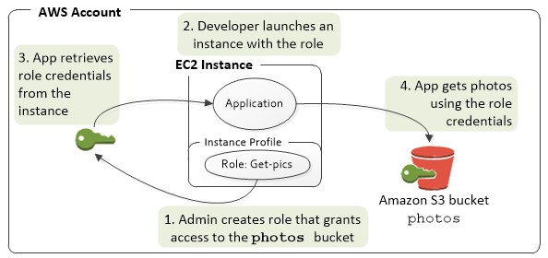

Slide 24
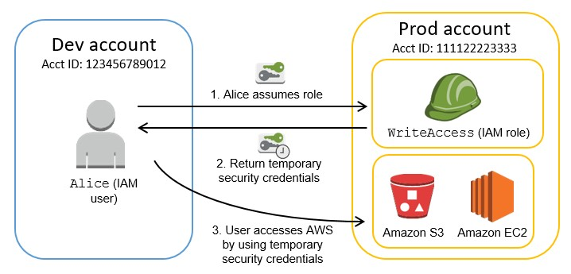

Slide 25
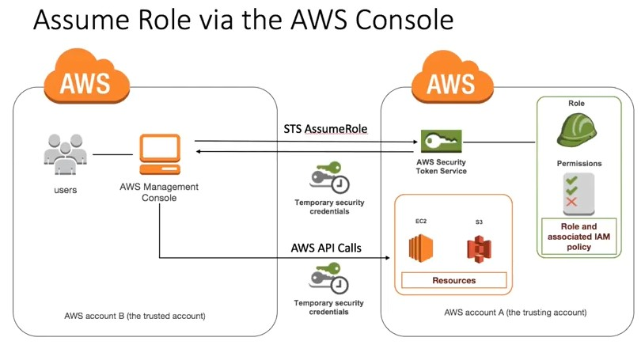
In Trusting Account Create a Role (MyCrossAcountRole)
Use Trusted Account ID for role creation (where users need to access - Trusting Account)
Attach a appropriate policy to the role
Copy the Role ARN and Click Create.
In Trusted Account create a Policy (AssumeRolePolicy), allowing STS, with action AssumeRole and paste the MyCrossAccountRole ARN
Click Create
Attach the AssumeRolePolicy to respective group for cross account access

Slide 26



Amazon Cognito provides authentication, authorization, and user management for your web and mobile apps
Users can sign in directly with a user name and password, or through a third party such as Facebook, Amazon, or Google
Two main components of Amazon Cognito are user pools and identity pools
User pools are user directories that provide sign-up and sign-in options for your app users
Identity pools enable you to grant your users access to other AWS services
Can use identity pools and user pools separately or together.

Slide 27
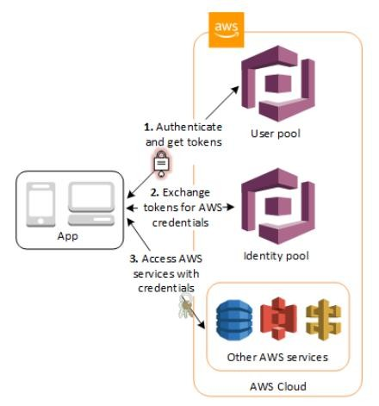

Slide 28

IAM is Universal. It does not apply to regions
The “root account” is simply the account created when first setup your AWS account. It has full Admin Access.
New Users have NO permissions when first created.
New Programmatic Users are assigned Access Key ID & Secret Access Key when first created.
These are not same as the password, and you cannot use it to login into the console. You can use this to access AWS via the APIs and Command Line however.
You only get to view these credentials once. If you lose them, you have to regenerate them. So save them in a secure location.

Slide 29

Always setup Multifactor Authentication on your root account.
You can create and customize your own password rotation policies.

